Slide 1

SQL Capstone Project
Cool T-Shirts First and Last Touch Attribution
Kaivan Adjedani
August 21st 2018

Slide 2
Table of Contents
1 – Getting to Know the Numbers
2 – First Touch
3 – Last Touch
4 – The User Journey
5 – Business Recommendations

Slide 3
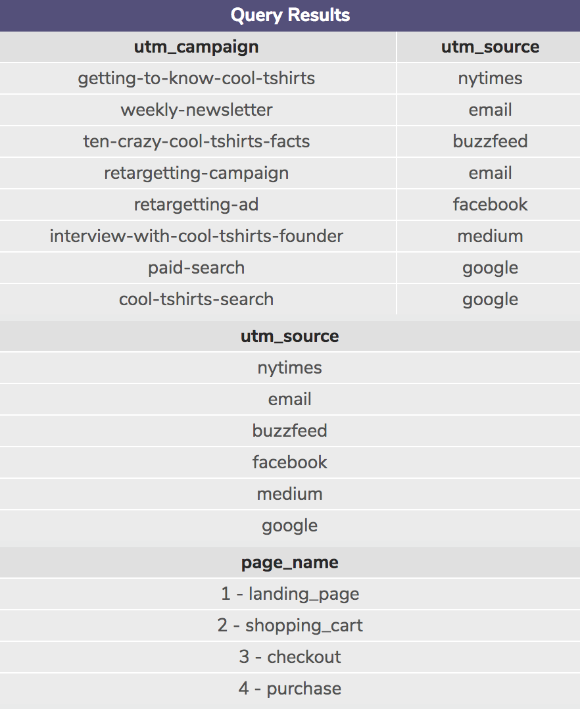
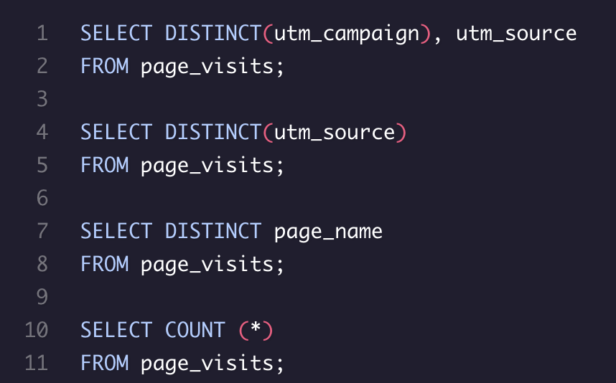
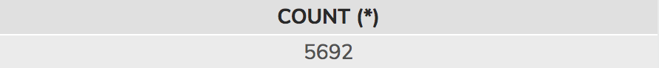
From the queries below we find that there are 8 distinct (or unique) campaigns, and 6 distinct sources used by CoolTShirts, shown to the right
We could have used separate queries for distinct utm_source and utm_campaign, then a third for relation; query below is more time efficient
SELECT COUNT(*) was not required, but helps get a feel of the data (5692 results)

Slide 4
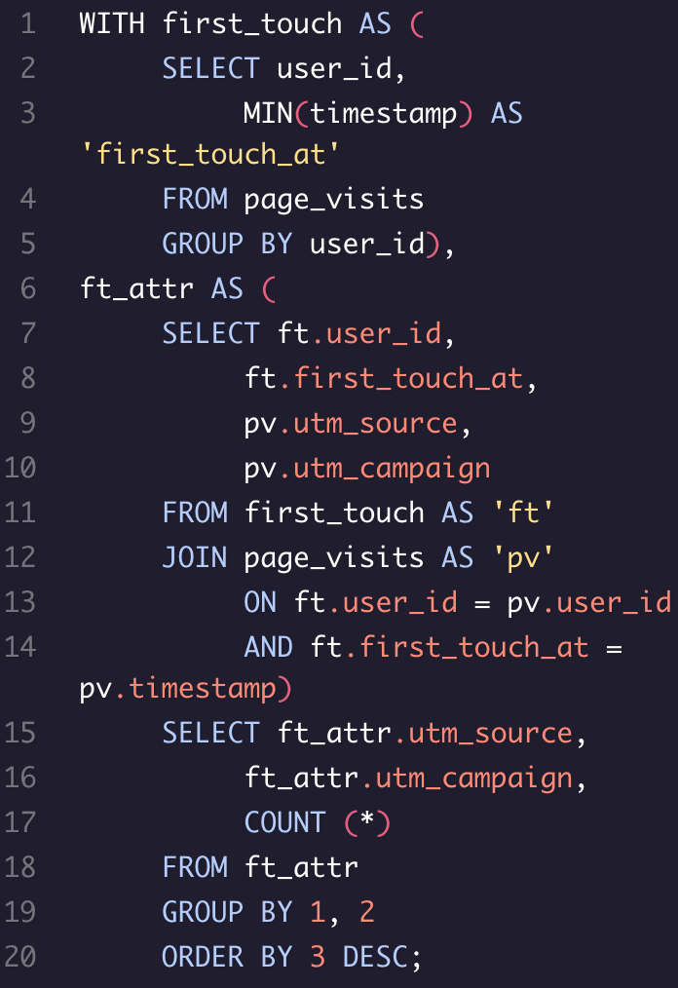
The queries to the right show how to calculate first touch attribution
By selecting the minimum timestamp next to user_id, we are able to determine their first touch; by selecting the minimum of their timestamps we can see the first time they visited the site
The table below the queries shows how many first touches each campaign, and source, is responsible for
ft_attr.utm_source | ft_attr.utm_campaign | COUNT(*)
Medium | Interview-with-cool-tshirts-founder | 622
NYTimes | getting-to-know-cool-tshirts | 612
Buzzfeed | ten-crazy-cool-tshirts-facts | 576
Google | cool-tshirts-search | 169

Slide 5
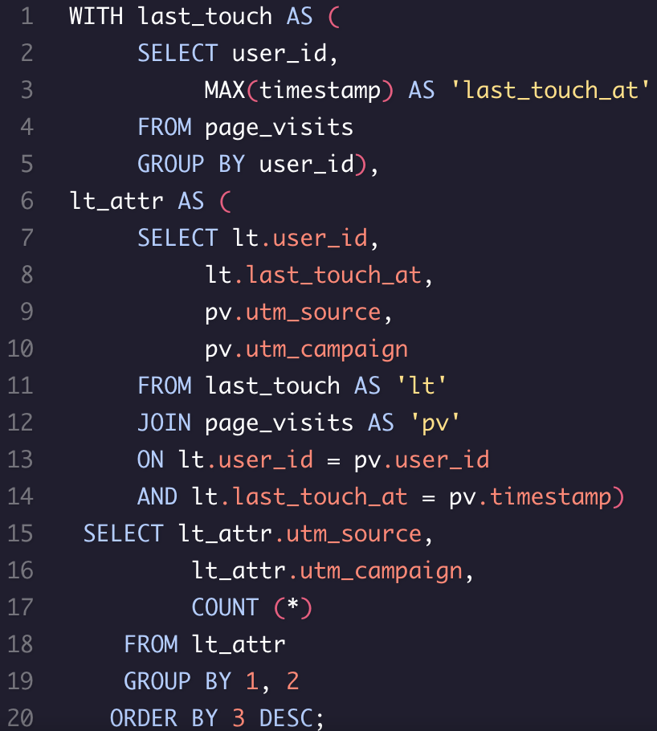
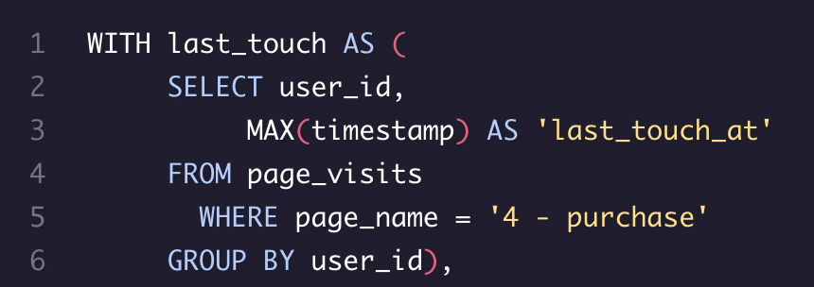
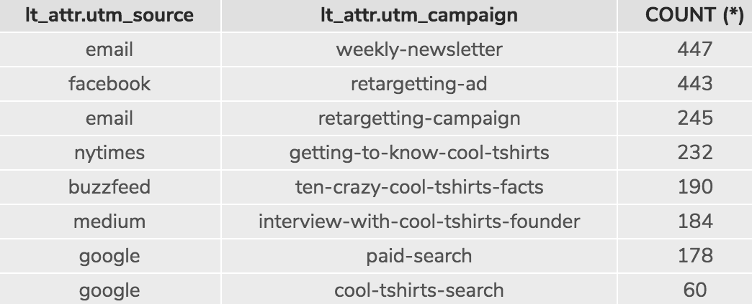
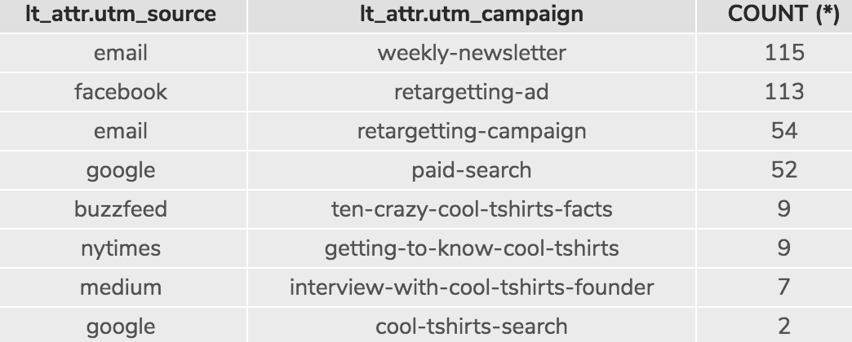
Using almost an identical code as the last slide, however with max(timestamp), we can determine the last touch attribution as well
The last touches each campaign, and source, are responsible for are shown to the right
By adding a WHERE query (shown below), we can determine how many last touches lead to a purchase
- Shown to the left, using the WHERE function, the first row shows that 115 people made it to the purchase page from the weekly newsletter of the email campaign

Slide 6
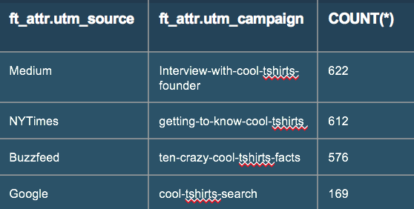
What is the Typical User Journey?
The typical user journey can be interpreted from the results
Of all the initial site visitors, 1900 users made it to the shopping cart, 1431 made it to checkout, and 361 users made a purchase
There were originally 5692 users, 361 made a purchase, which means 6% of users who visited the site purchased a product
Below how many of the users who made their first touch from one of the four campaigns, ended up purchasing a product as a result of the last touch of that campaign
Ie. Of 622 first touch users from Medium, only 7 had their last touch at the purchase page

Slide 7
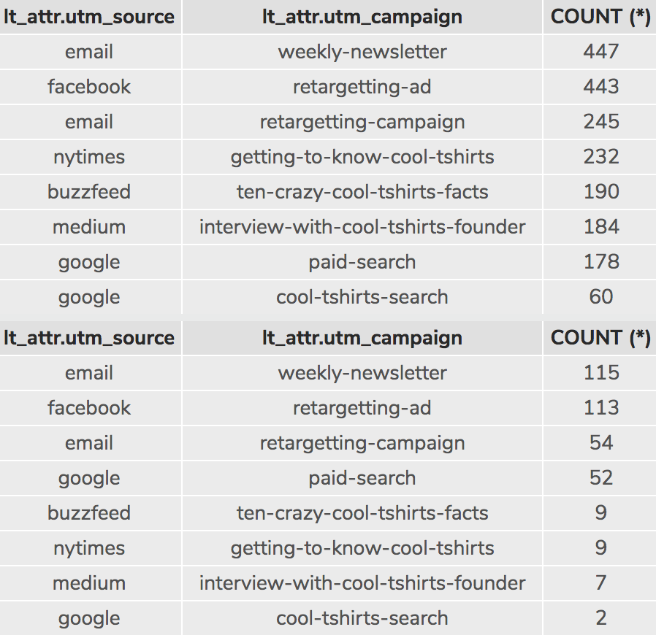
Business Proposal
Shown to the right is the amount of last touches and last touches that lead to the purchase page
Should CoolTShirts invest in 5 campaigns, those campaigns should be: - Email Weekly Newsletter
Facebook Retargetting Ad
Email Retargetting Ad
Google Paid Search
Buzzfeed Article
Of all the ads, the google paid-search seems to be the most efficient. The last touch to purchase percentage is at about 25%.

